Slide 1

COMPUTER NETWORKS
Transport Layer
Animesh Giri
Department of Computer Science & Engineering

Slide 2

COMPUTER NETWORKS
Pipelined protocols
Animesh Giri
Department of Computer Science & Engineering

Slide 3
In this segment
COMPUTER NETWORKS
Pipelined protocols
Pipelining: increased utilization
Pipelined protocols: overview
Go-Back-N: sender
GBN: sender extended FSM
GBN: receiver extended FSM
Selective repeat
Selective repeat: sender, receiver windows
Selective repeat in action
Selective repeat: dilemma

Slide 4
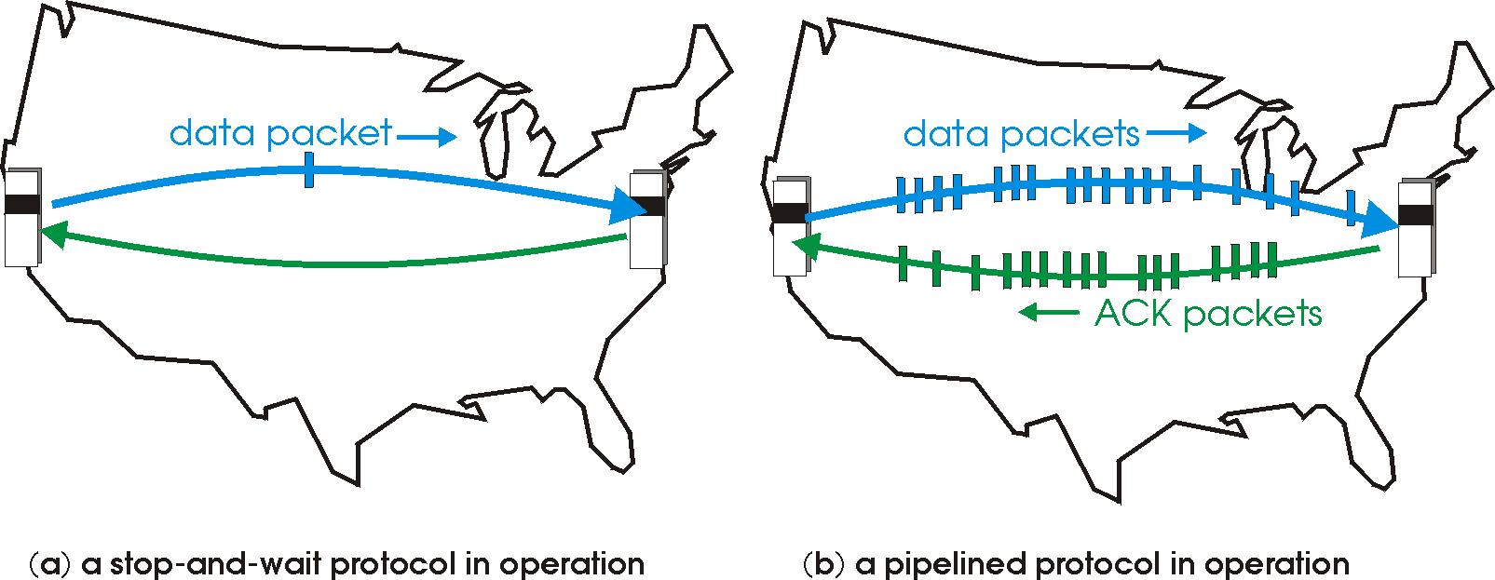

COMPUTER NETWORKS
Pipelined protocols
pipelining: sender allows multiple, “in-flight”, yet-to-be-acknowledged pkts
range of sequence numbers must be increased
buffering at sender and/or receiver
two generic forms of pipelined protocols: go-Back-N, selective repeat

Slide 5
COMPUTER NETWORKS
Pipelining: increased utilization
sender
receiver
first packet bit transmitted, t = 0
last bit transmitted, t = L / R
first packet bit arrives
RTT
last packet bit arrives, send ACK
last bit of 2nd packet arrives, send ACK
last bit of 3rd packet arrives, send ACK
ACK arrives, send next
packet, t = RTT + L / R
3-packet pipelining increases
utilization by a factor of 3!

Slide 6
COMPUTER NETWORKS
Pipelined protocols: overview
Go-back-N:
sender can have up to N unacked packets in pipeline
receiver only sends cumulative ack
doesn’t ack packet if there’s a gap
sender has timer for oldest unacked packet
when timer expires, retransmit all unacked packets
Selective Repeat:
sender can have up to N unack’ed packets in pipeline
rcvr sends individual ack for each packet
sender maintains timer for each unacked packet
when timer expires, retransmit only that unacked packet

Slide 7
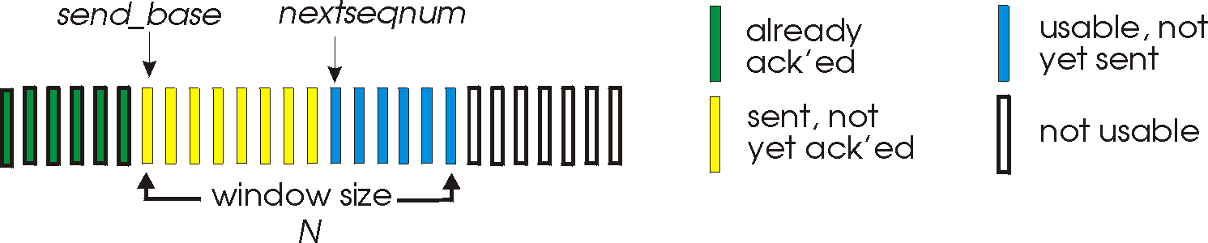
COMPUTER NETWORKS
Go-Back-N: sender
k-bit seq # in pkt header
“window” of up to N, consecutive unack’ed pkts allowed
ACK(n): ACKs all pkts up to, including seq # n - “cumulative ACK”
may receive duplicate ACKs (see receiver)
timer for oldest in-flight pkt
timeout(n): retransmit packet n and all higher seq # pkts in window

Slide 8
COMPUTER NETWORKS
GBN: sender extended FSM
rdt_send(data)
if (nextseqnum < base+N) {
sndpkt[nextseqnum] = make_pkt(nextseqnum,data,chksum)
udt_send(sndpkt[nextseqnum])
if (base == nextseqnum)
start_timer
nextseqnum++
}
else
refuse_data(data)
Λ
base=1
nextseqnum=1
timeout
Wait
start_timer
udt_send(sndpkt[base])
udt_send(sndpkt[base+1])
…
udt_send(sndpkt[nextseqnum-1])
rdt_rcv(rcvpkt)
&& corrupt(rcvpkt)
rdt_rcv(rcvpkt) &&
notcorrupt(rcvpkt)
base = getacknum(rcvpkt)+1
If (base == nextseqnum)
stop_timer
else
start_timer

Slide 9
COMPUTER NETWORKS
GBN: receiver extended FSM
default
udt_send(sndpkt)
rdt_rcv(rcvpkt)
&& notcurrupt(rcvpkt)
&& hasseqnum(rcvpkt,expectedseqnum)
Λ
Wait
extract(rcvpkt,data)
deliver_data(data)
sndpkt = make_pkt(expectedseqnum,ACK,chksum)
udt_send(sndpkt)
expectedseqnum++
expectedseqnum=1
sndpkt =
make_pkt(expectedseqnum,ACK,chksum)
ACK-only: always send ACK for correctly-received pkt with highest in-order seq #
may generate duplicate ACKs
need only remember expectedseqnum
out-of-order pkt:
discard (don’t buffer): no receiver buffering!
re-ACK pkt with highest in-order seq #

Slide 10

COMPUTER NETWORKS
GBN in action
sender window (N=4)
sender
receiver
0 1 2 3 4 5 6 7 8
send pkt0
send pkt1
send pkt2
send pkt3
(wait)
0 1 2 3 4 5 6 7 8
receive pkt0, send ack0
receive pkt1, send ack1
receive pkt3, discard,
(re)send ack1
0 1 2 3 4 5 6 7 8
X
0 1 2 3 4 5 6 7 8
loss
0 1 2 3 4 5 6 7 8
rcv ack0, send pkt4
rcv ack1, send pkt5
0 1 2 3 4 5 6 7 8
receive pkt4, discard,
(re)send ack1
ignore duplicate ACK
receive pkt5, discard,
(re)send ack1
pkt 2 timeout
0 1 2 3 4 5 6 7 8
send pkt2
send pkt3
send pkt4
send pkt5
0 1 2 3 4 5 6 7 8
0 1 2 3 4 5 6 7 8
rcv pkt2, deliver, send ack2
rcv pkt3, deliver, send ack3
rcv pkt4, deliver, send ack4
rcv pkt5, deliver, send ack5
0 1 2 3 4 5 6 7 8

Slide 11
COMPUTER NETWORKS
Selective repeat
receiver individually acknowledges all correctly received pkts
buffers pkts, as needed, for eventual in-order delivery to upper layer
sender only resends pkts for which ACK not received
sender timer for each unACKed pkt
sender window
N consecutive seq #’s
limits seq #s of sent, unACKed pkts

Slide 12
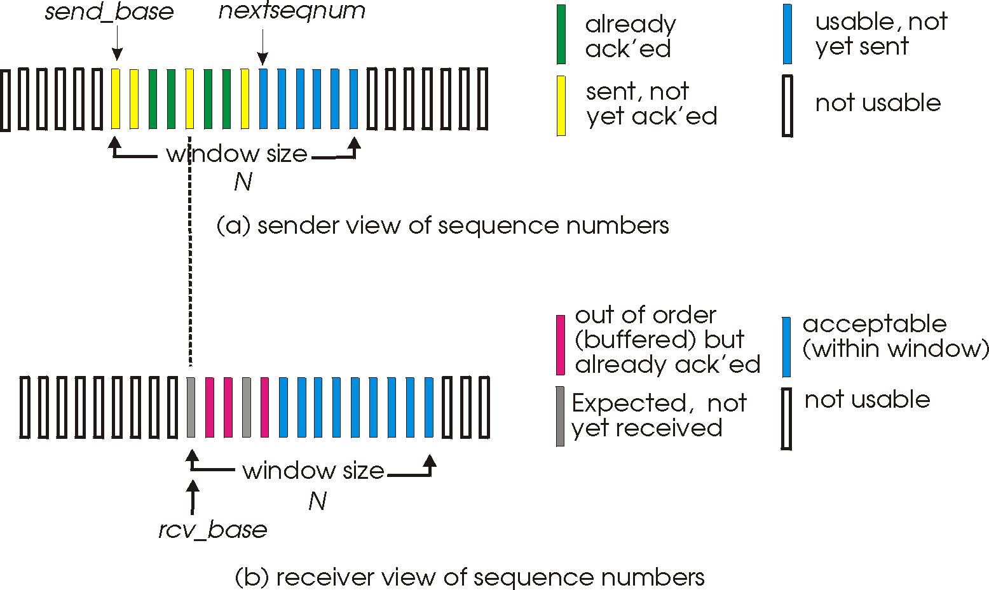
COMPUTER NETWORKS
Selective repeat: sender, receiver windows

Slide 13
COMPUTER NETWORKS
Selective repeat
sender
receiver
data from above:
if next available seq # in window, send pkt
timeout(n):
resend pkt n, restart timer
ACK(n) in [sendbase,sendbase+N]:
mark pkt n as received
if n smallest unACKed pkt, advance window base to next unACKed seq #
pkt n in [rcvbase, rcvbase+N-1]
send ACK(n)
out-of-order: buffer
in-order: deliver (also deliver buffered, in-order pkts), advance window to next not-yet-received pkt
pkt n in [rcvbase-N,rcvbase-1]
ACK(n)
otherwise:
ignore

Slide 14
COMPUTER NETWORKS
Selective repeat in action
sender window (N=4)
sender
receiver
0 1 2 3 4 5 6 7 8
send pkt0
send pkt1
send pkt2
send pkt3
(wait)
0 1 2 3 4 5 6 7 8
receive pkt0, send ack0
receive pkt1, send ack1
receive pkt3, buffer,
send ack3
0 1 2 3 4 5 6 7 8
X
0 1 2 3 4 5 6 7 8
loss
0 1 2 3 4 5 6 7 8
rcv ack0, send pkt4
rcv ack1, send pkt5
0 1 2 3 4 5 6 7 8
receive pkt4, buffer,
send ack4
record ack3 arrived
receive pkt5, buffer,
send ack5
pkt 2 timeout
0 1 2 3 4 5 6 7 8
send pkt2
0 1 2 3 4 5 6 7 8
record ack4 arrived
0 1 2 3 4 5 6 7 8
rcv pkt2; deliver pkt2,
pkt3, pkt4, pkt5; send ack2
record ack5 arrived
0 1 2 3 4 5 6 7 8
Q: what happens when ack2 arrives?

Slide 15

COMPUTER NETWORKS
sender window
(after receipt)
receiver window
(after receipt)
Selective repeat: dilemma
0 1 2 3 0 1 2
pkt0
0 1 2 3 0 1 2
pkt1
0 1 2 3 0 1 2
example:
seq #’s: 0, 1, 2, 3
window size=3
0 1 2 3 0 1 2
pkt2
0 1 2 3 0 1 2
0 1 2 3 0 1 2
0 1 2 3 0 1 2
pkt3
X
0 1 2 3 0 1 2
pkt0
will accept packet
with seq number 0
receiver sees no difference in two scenarios!
duplicate data accepted as new in (b)
Q: what relationship between seq # size and window size to avoid problem in (b)?
(a) no problem
receiver can’t see sender side.
receiver behavior identical in both cases!
something’s (very) wrong!
0 1 2 3 0 1 2
pkt0
0 1 2 3 0 1 2
pkt1
0 1 2 3 0 1 2
0 1 2 3 0 1 2
pkt2
0 1 2 3 0 1 2
X
0 1 2 3 0 1 2
X
timeout
retransmit pkt0
X
0 1 2 3 0 1 2
pkt0
will accept packet
with seq number 0
(b) oops!

Slide 16

THANK YOU
Animesh Giri
Department of Computer Science & Engineering
animeshgiri@pes.edu
+91 80 66186603

